Slide 1
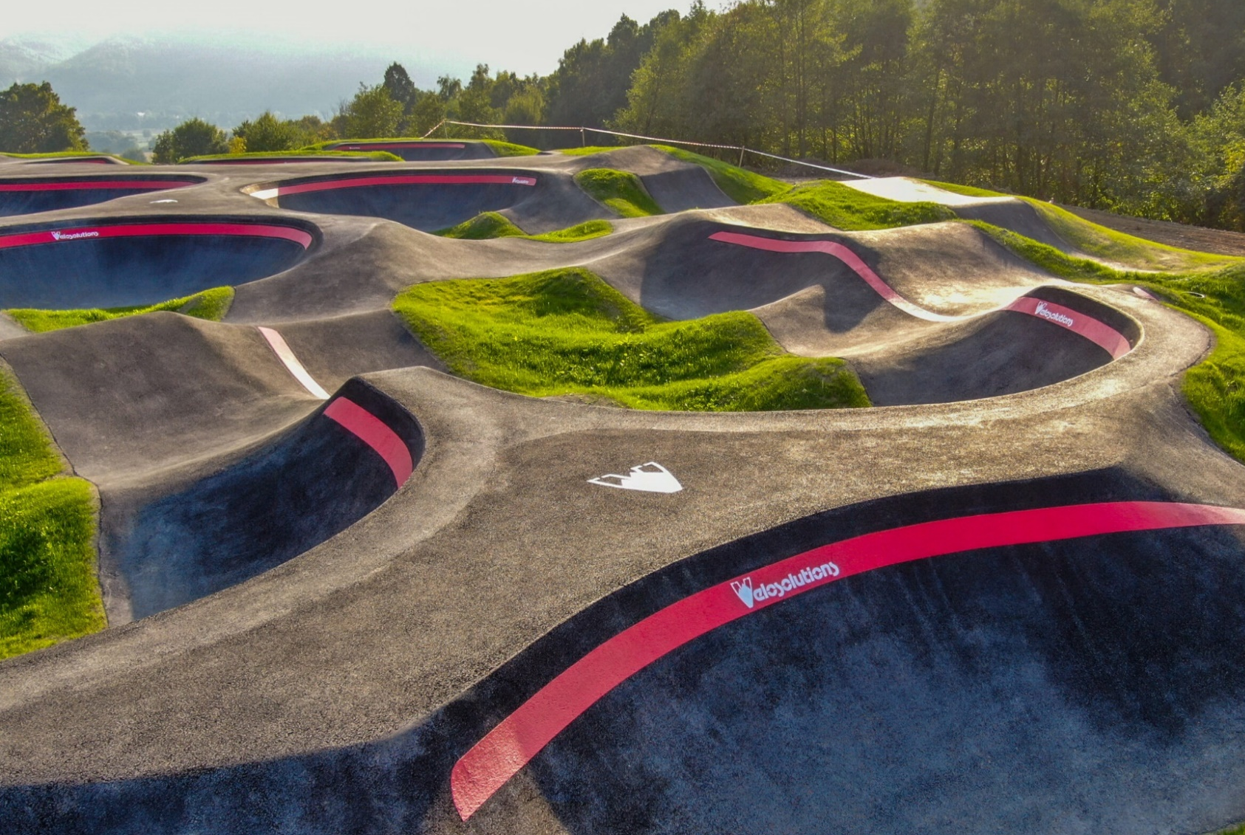
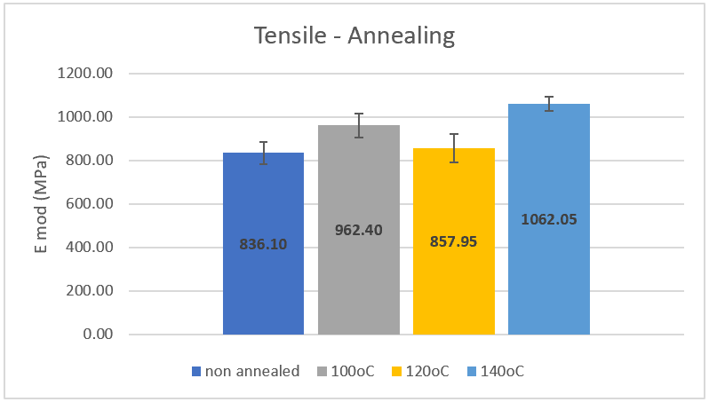
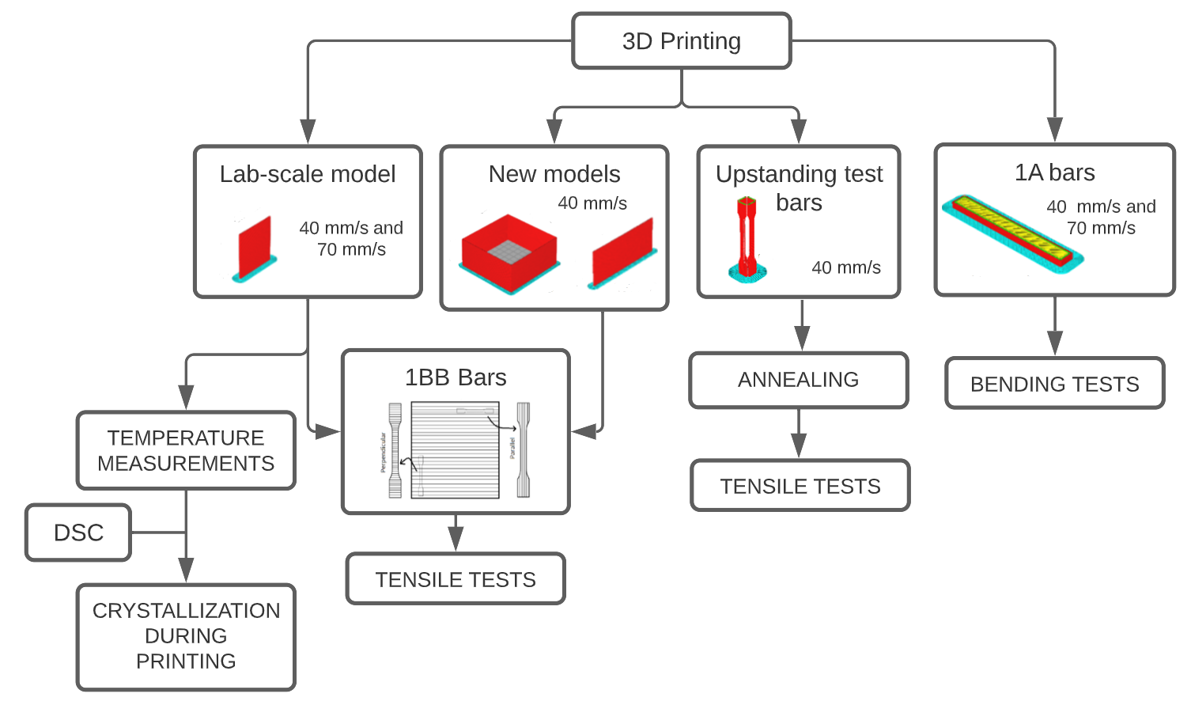
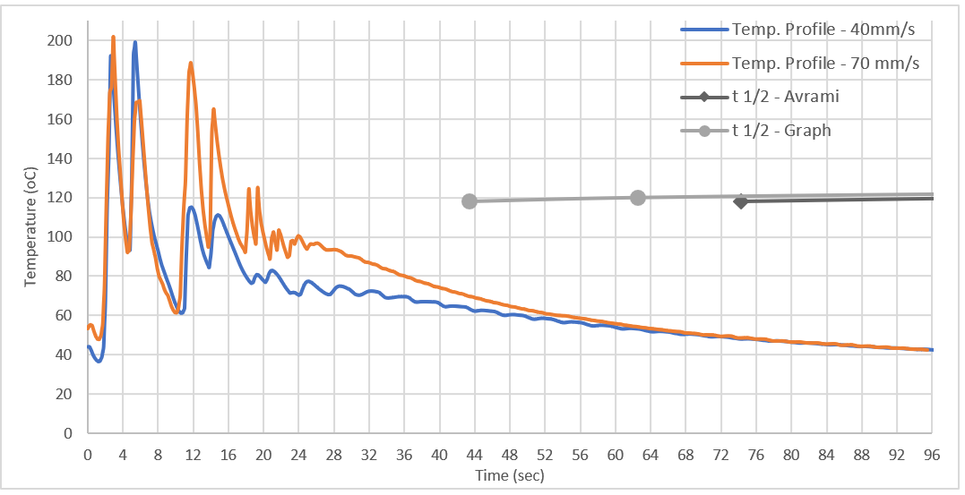
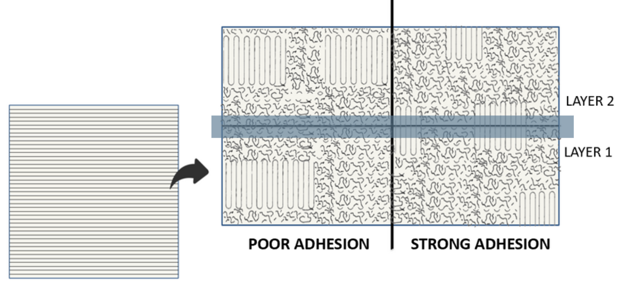
Circular 3D Printing
Developing a small scale model for 3D printing pump tracks
CfD: Mariana Gouvea, Luciënne Bollen-Bouvrie, Chantalle Zwarthoed and Tosca van Hooy
Introduction
Results
Pump tracks, made with recycled polyethylene terephthalate glycol, have been 3D printed by ICycle, but, due to a poor layer to layer adhesion, they break quickly. A lab-scale model has been developed, so studies can be done easiliy and with less material ^{[1].}
MECHANICAL PERFORMANCE
This project aims discover how to make better 3D printed pump tracks, in terms of their mechanical properties, by changing the printing settings and the polymer used. Glass fiber reinforced polpypropylene (20% and 30%) and SmartAgain® were studied.
Figure 5 – Tensile and Bending strain vs stress curve for SmartAgain® and PP 30% GF
SmartAgain® behaves more ductile than glass fiber reinforced polypropylene (30% GF), making it more suitable for 3D printing pump tracks.
Figure 1 – Pump track ^{[2]}
Materials & Methods
Annealed samples presented a higher E-modulus than the non-annealed ones.
Melt-recrystallization may have occured ^{[3]} .
Figure 6 – Tensile E-mod for SmartAgain® anneale samples
Figure 2 – Flowchart of the methods
Figure 7 – Tensile E-mod for SmartAgain® new models
Results
New lab-scale models started to be developed, so big-scale printing at different speeds could be studied. The tested samples resulted in different E-modulus, but more experiments must be performed to make better conclusions.
CRYSTALLIZATION DURING PRINTING
Discussion & Conclusions
Crystallization is not completed for the first deposition of material. When a new layer is deposited, there is still time for the chains to move and for the crystals to form between layers.
SmartAgain® behaves ductile when compared to polypropylene filled with glass fibers, which points it out as a good material for 3D printing the pump tracks;
Annealing showed to be a thermal treatment that affects SmartAgain® mechanical performance, increasing E-modulus;
Production scale tests still need to be done so a new lab-scale model can be completely tested and developed.
Figure 3 – Temperature profile and crystallization curve for SmartAgain®
Dankwoord (optioneel)
References:
[1] Vranken, Finn. Procesanalyse aan het 3D-printen van rPETG pumptracks. Applied Science, Material Science, 2021;
[2] Velosolutions. Velosolutions Pump Track Heipark. Photos. Accessed from: https://pumptrack.com/track/velosolutions-pump-track-heipark/;
[3] Li, Jie et. al. Effect of annealing temperature on the mechanical properties, thermal behavior and morphology of β-iPP/PA6 blends. Materials and Design. 2012. DOI: 10.1016/j.matdes.2012.04.022.
Figure 4 – Crystallization and layer to layer adhesion for FDM printing
SmartAgain® does not completely crystallize with the first deposition of material, leaving room for the chains to move and crystals to form between layers.
Contact: Mariana Gouvea (mariana.gouvea99@gmail.com)
Research Centre Material Sciences
Lector Gino van Strijdonck
Faculty of Bèta Sciences and Technology, Heerlen, The Netherlands
www.zuyd.nl/onderzoek/lectoraten/material-science
Chemelot Innovation and Learning Labs, Brightlands Chemelot Campus, The Netherlands

